Slide 1

Tuska University student registration system
Jamain hughes
the university of arizona global campus
CST 499: capstone for computer software technology
Professor: Dr. Amjad alkilani
January 29, 2024

Slide 2
Topics of Discussion
Summary of the key aspects of the SRS document for my student registration system.
Showcase of the UML design model that I created.
Explanation of the design of the landing, login, and enrollment pages.
Explanation of the MySQL database and class registration that I developed.
Discussion of the PHP code that I wrote.

Slide 3
SRS for Student Registration System
Contents
1.Introduction
2.Overall Description
3.External Interface Requirements
4.System Features
5.Other Nonfunctional requirements

Slide 4
SRS Document for student registration system
Purpose
The purpose of this Software Requirements Specification (SRS) document is to outline the functional and non-functional requirements for the development of my student registration system that provides a way for students to enroll into courses for an online institute.

Slide 5
SRS document for the student registration system
Product Scope
This project is essentially a student registration system. The overall goal of this student registration system is to allow students to easily manage their course schedules. Students will be able to register as a new student and create their account and profiles. Students will also be able to enroll themselves into courses if they are available during the respected semester. If the desired course is not available, students can add themselves into a waiting list. Students will also be able to cancel their enrollment from any course that they are enrolled in, and the system should inform the first in the waiting list that they can enroll into the class. This project aligns with the business objectives to hold onto students, improve the student's online college experience, and reduce costs while increasing the speed of the college registration process compared to manually registering students.

Slide 6
SRS Document for the student registration system
Product Perspective
New self-contained project
Product Functions
Account creation, login/logout, search for courses, view course schedule, register/drop courses
User Classes
Administrative assistant, students, registrar staff.
Operation Environment
Available across all platforms, major web browsers, and mobile devices.

Slide 7
SRS Document for the student registration system
Design and Implementation Constraints
Policy compliance: ADA web accessibility and FERPA
Project timeline: 3 months
Technologies: MySQL, PHP, HTML5, CSS, JavaScript, XAMPP, ATOM

Slide 8

UML Design Model

Slide 9
UML Design Model
Purpose
UML diagrams are used to analyze existing software, model new software, and plan software development and prioritization. They aid software engineers in visualizing a software system.

Slide 10
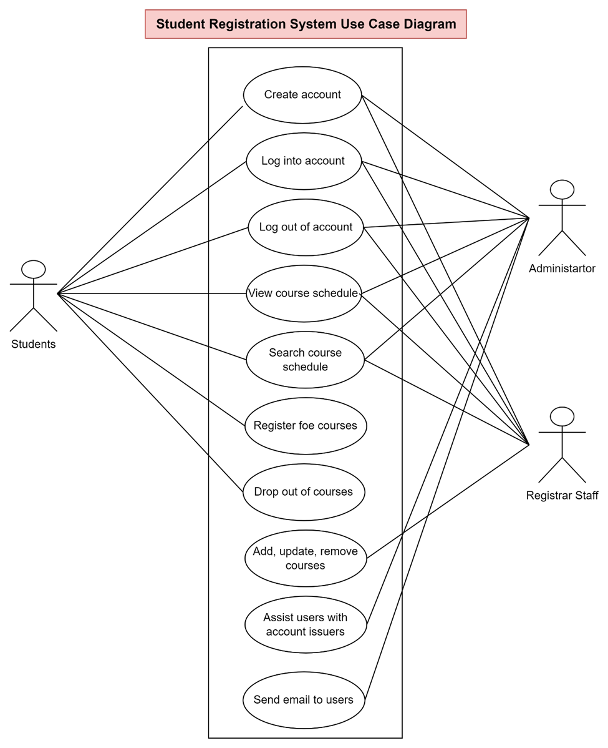
UML Design model: Use Case Diagram
A use case diagram is a way to summarize details of a system and the users within that system. The graphic depiction of the student registration system shows the interactions among different elements in the system

Slide 11
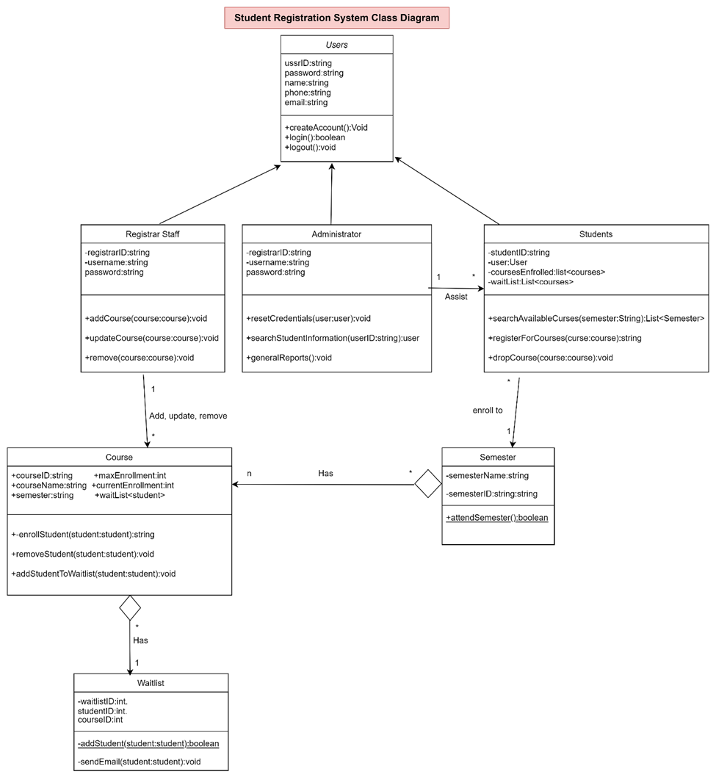
UML Design model: Class diagram
A class diagram is a type of static structure diagram that describes the structure of a system by showing the system’s classes, their attributes, operations, and relationships among objects. Class diagrams are the most important kind of UML diagram and vitally important in software development because they are the best way to illustrate a system’s structure in a detailed way.

Slide 12
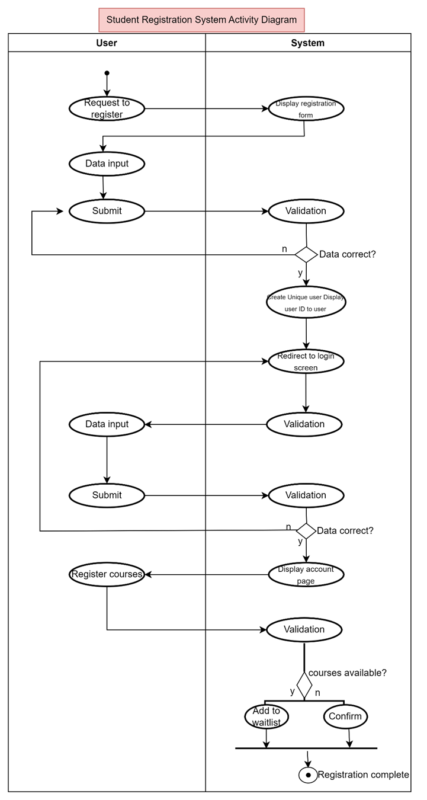
UML Design model: Activity Diagram
An activity diagram is essentially an advanced version of a flow chart that models the flow from one activity to another activity. Activity diagrams allow coordination between events that need to be achieved by some operations, particularly where the operation is intended to achieve a number of different things that require coordination, or how the events in a single use case relate to one another.

Slide 13
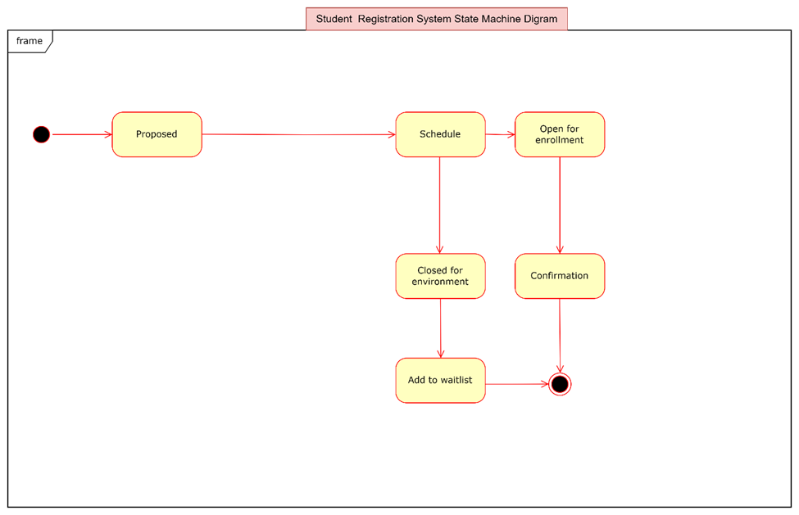
UML Design model: State Diagram
A state diagram is a type of diagram used to describe the behavior of a software system. State diagrams consist of states, transitions, events, and activities. State diagrams are important because they enable software development to describe the behavior of objects during their entire life cycle.

Slide 14
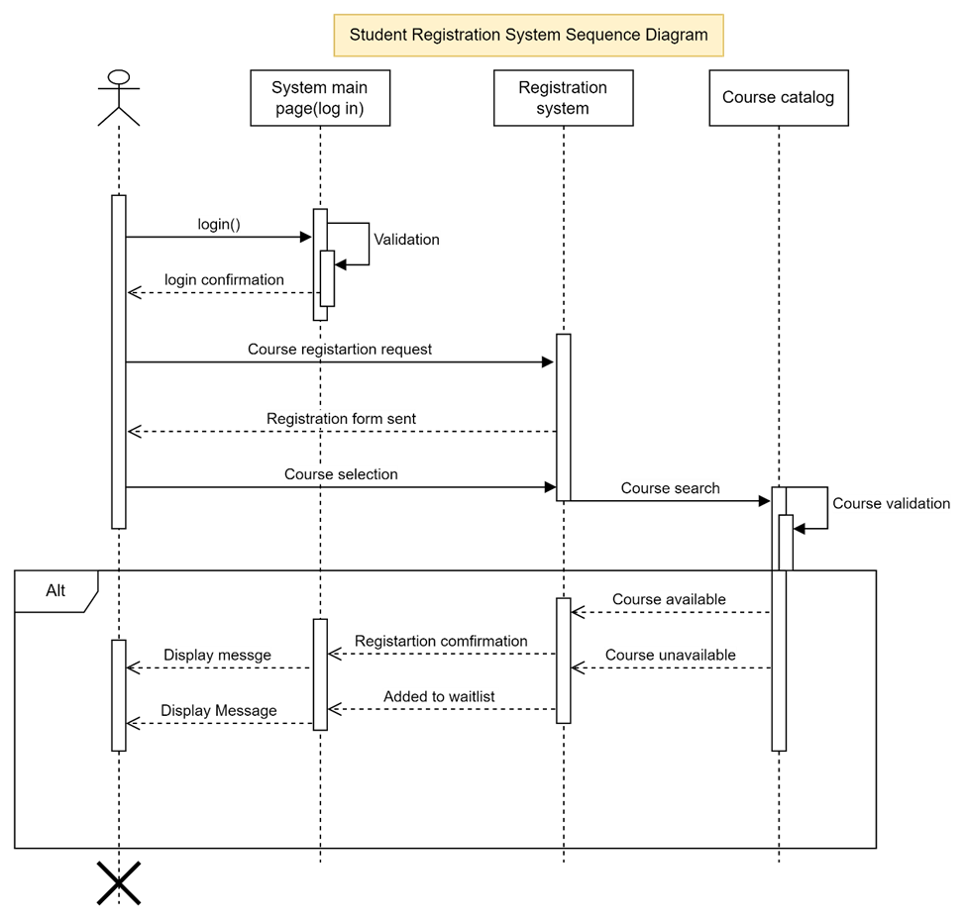
UML Design model: Sequence Diagram
A sequence diagram is an interaction diagram that details how operations are carried out and what messages are sent and when. Sequence diagrams show the sequence of messages passed between objects. They can also show the control structure between objects. Activity diagrams are important because they show the flow of one activity to another within a system or process.

Slide 15
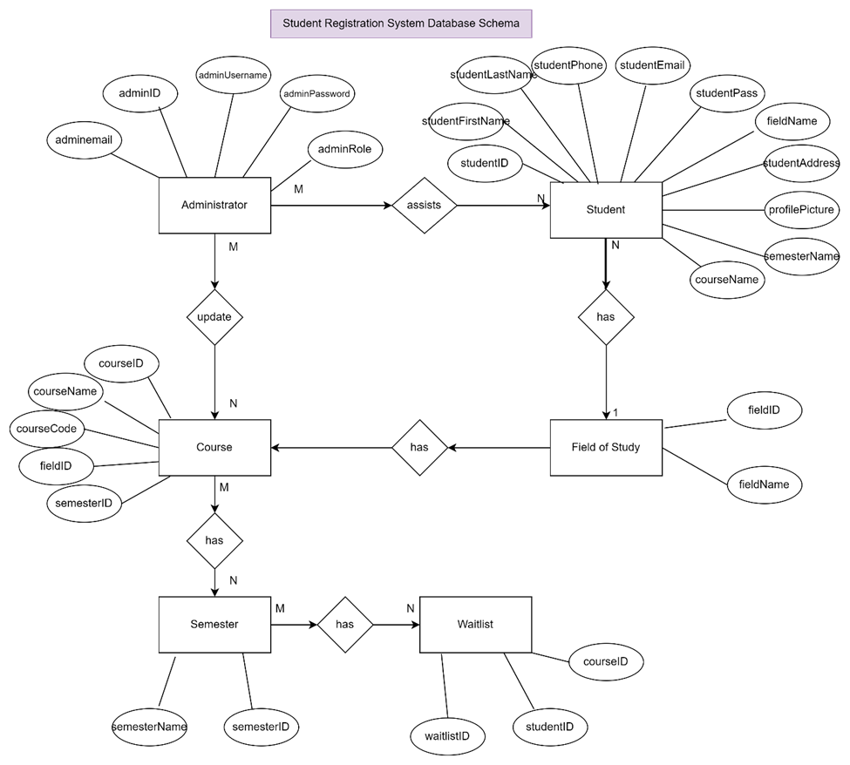
UML Design models: Database schema
A database schema is a collection of database objects, including tables, views, indexes, stored procedures, and more, that defines the structure and organization of a database. It provides a blueprint or framework for how data is stored, organized, and accessed within a database management system (DBMS). The schema defines the relationships between different entities and the rules and constraints that govern the data. Database Schemas are important because they promote data integrity, security, and data independence for software systems.

Slide 16
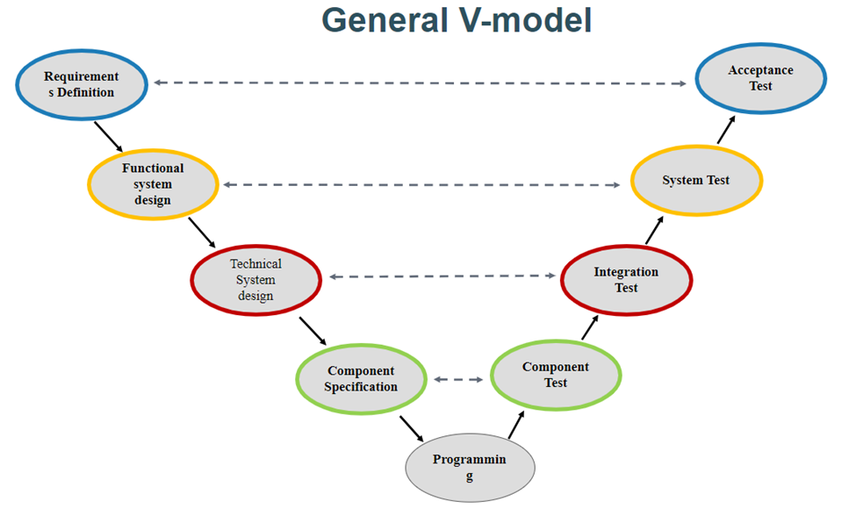
UML Design model: general v-model
Throughout this project I have used the General V-model method. This SDLC model allowed me to execute all of the stages within my software system lifecycle in a sequential manner.

Slide 17

Landing, Login, and Enrollment Pages
Tuska University Website
Notes:
After the planning and design stages of the system, I started with the implementation stage of my student registration system. The name of the university that will be carrying out the functions of this software system is called Tuska University. The first pages that I created for this website is the landing, login, and enrollment pages.

Slide 18
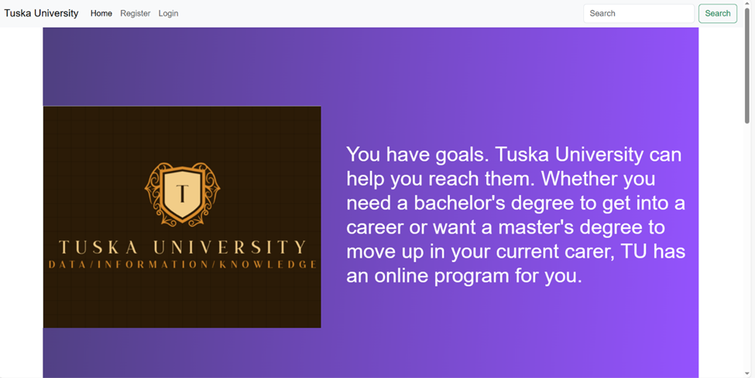
Landing Page
Notes:
The landing page is the very first page that the user will see after entering the server for my website. This page has a very simplistic layout that looks appealing to new users. The landing page also have a navbar that will aid users in navigating throughout the whole website. The navbar is designed to promote usability for my website as it provides an easy way for users to find the webpages that they desire.

Slide 19

Landing Page Cont.
Notes:
This is a the second part of my landing page. As you can see I have structured the landing page to display information about the university to appeal to new users.

Slide 20

Landing Page Cont.
Notes:
I used HTML and CSS to make the landing page look appealing to new users. As they stroll through the landing page looking for an higher education, they will be presented with a "register now" button at the bottom of the webpage incase they would like to enroll into the university.

Slide 21
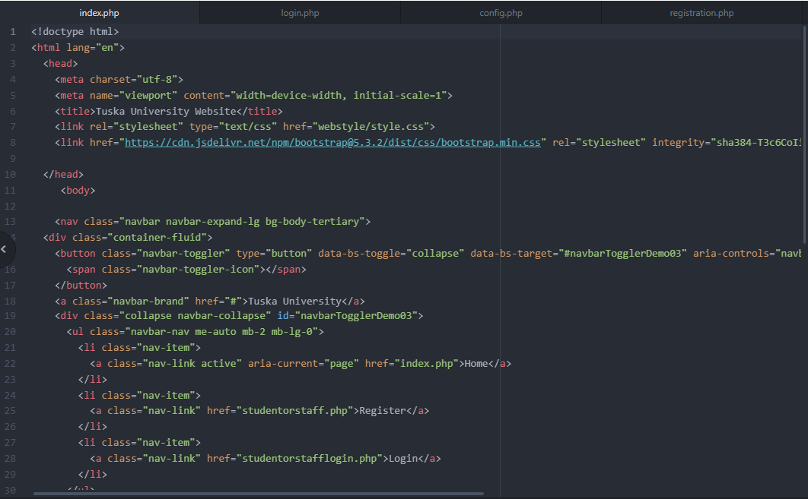
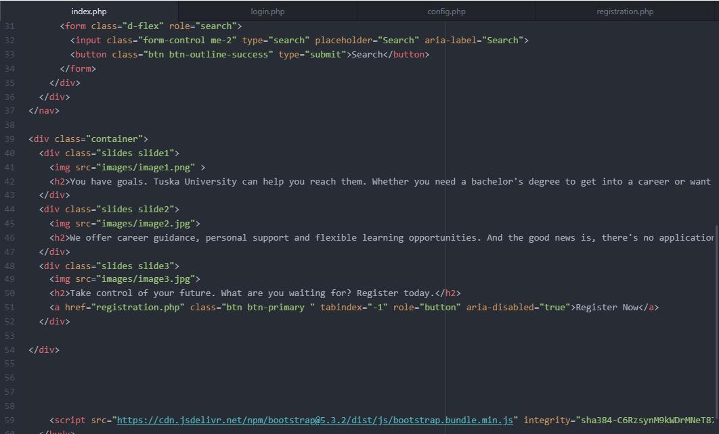
Landing Page Php code
Notes:
This is the code for my landing page. This code is a gateway to connecting the rest of my website together.

Slide 22
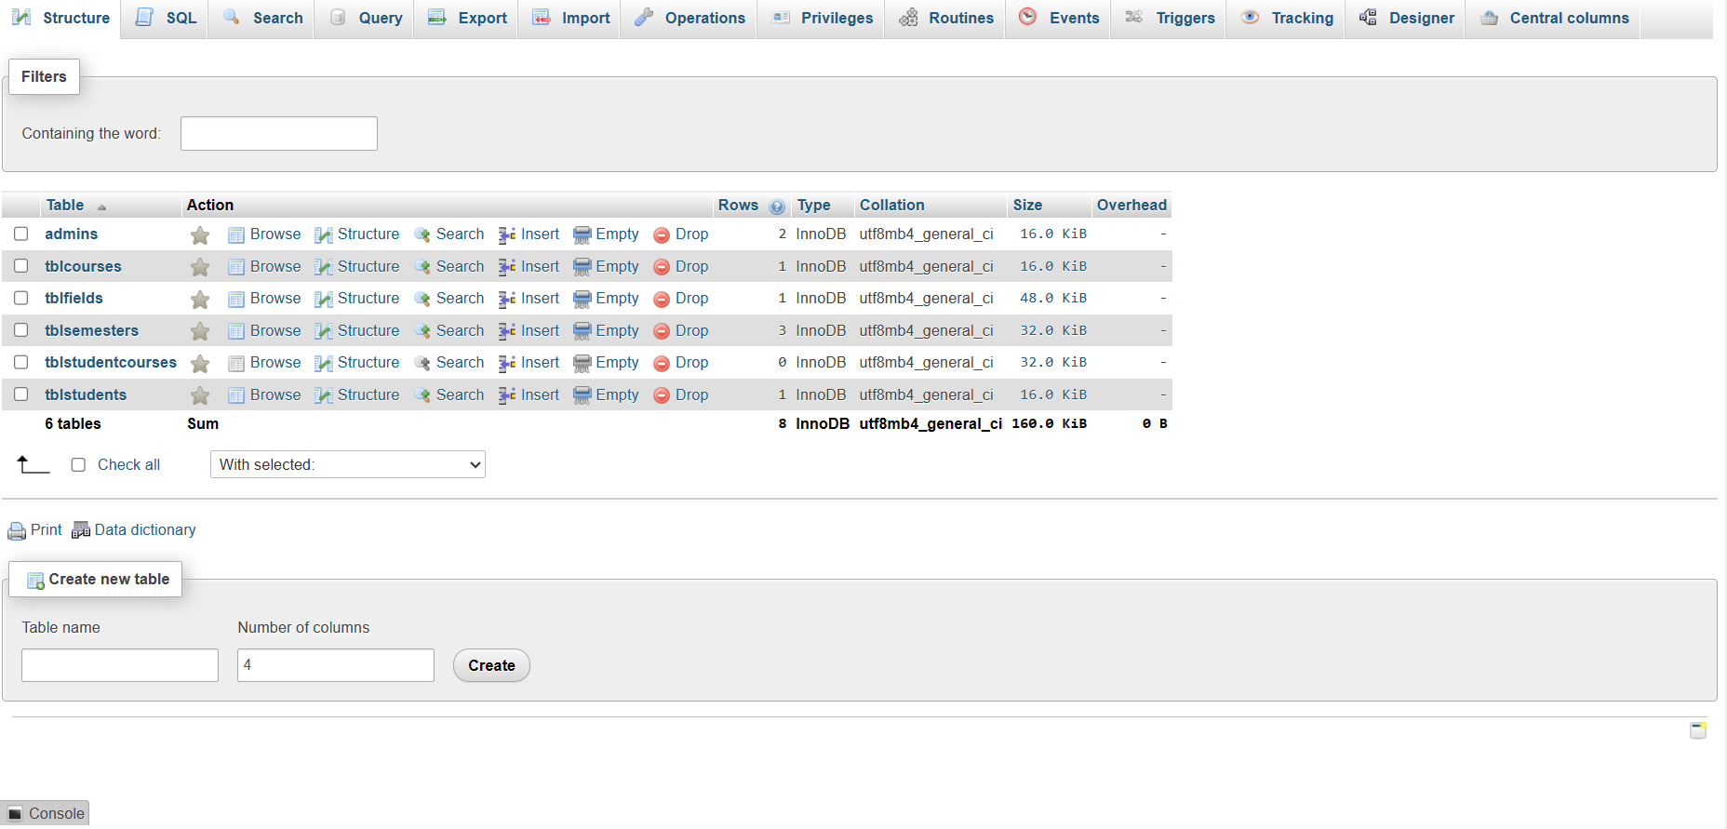
Tuska university database
Notes:
This is the database schema used throughout this software system. This database have six tables. These tables are called admins, tblcourses, tblfields, tblsemesters, tblstudentcourses, and tblstudents.

Slide 23
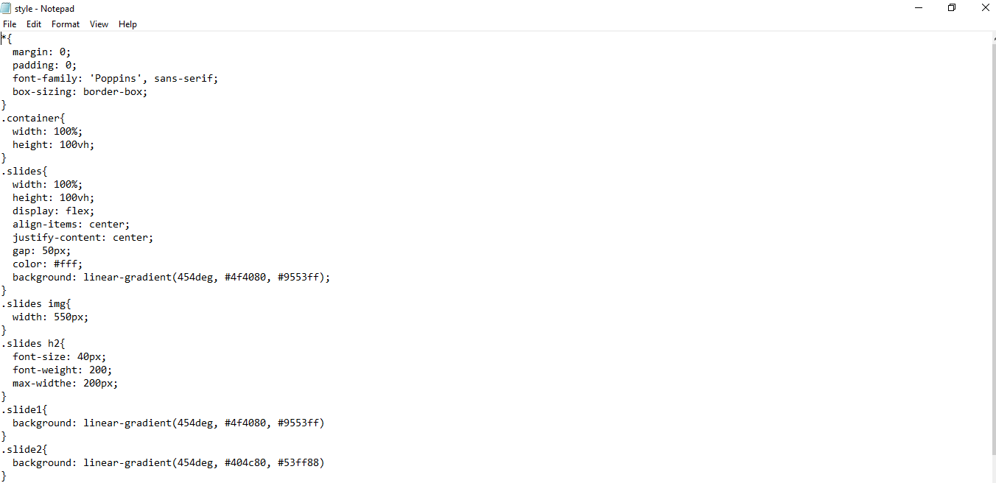
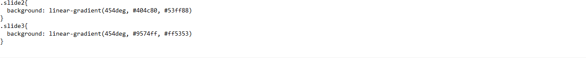
Landing Page CSS Code
Notes:
This is the cascading style sheet of my landing page. This code is responsible for the color and positional design of my landing page.

Slide 24
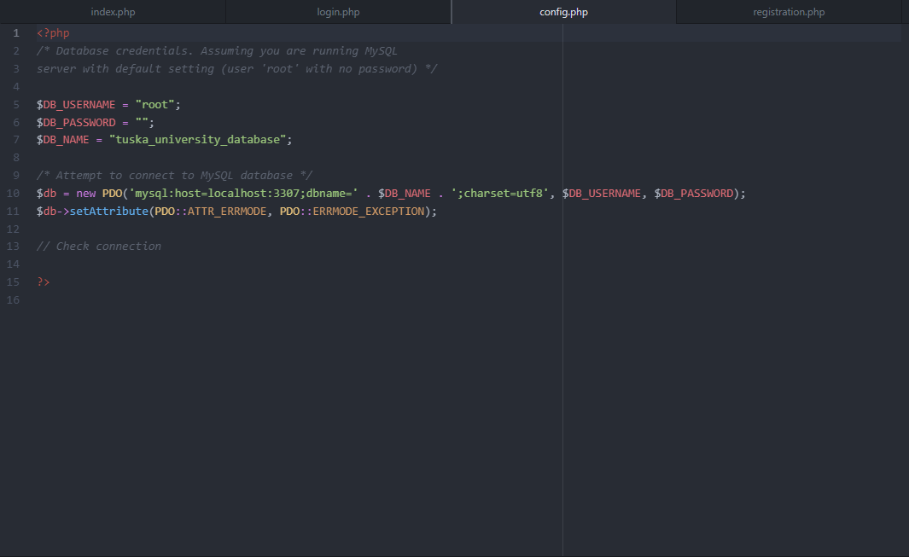
Tuska University database configuration
Notes:
After making the landing page, I needed a way for my database to connect with my website so, I created a file named "config.php" to make the proper connection to my database.

Slide 25
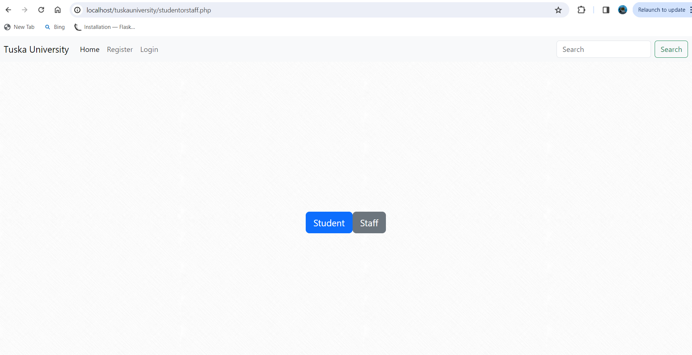
Tuska University user registration
Notes:
This is the very first page every user will see when they are trying to register as a user. After a new user click on register, they will be asked if they are trying to register as a student of staff.

Slide 26
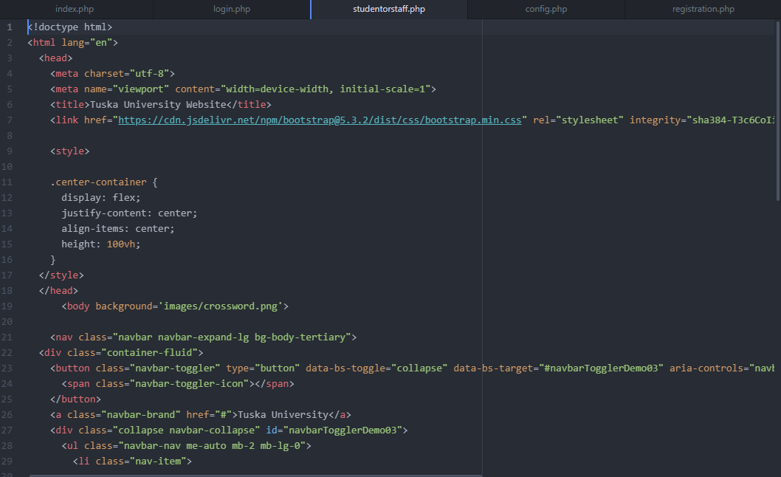
Registration PHP code
Notes:
This is the PHP code for the option for users to pick what the are trying to register as.

Slide 27
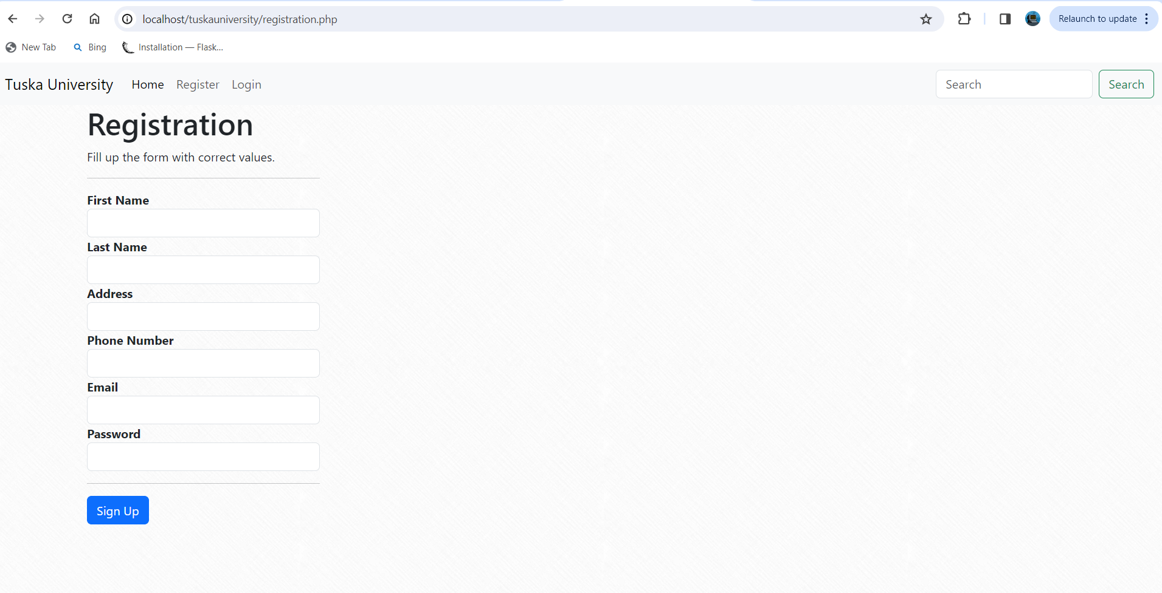
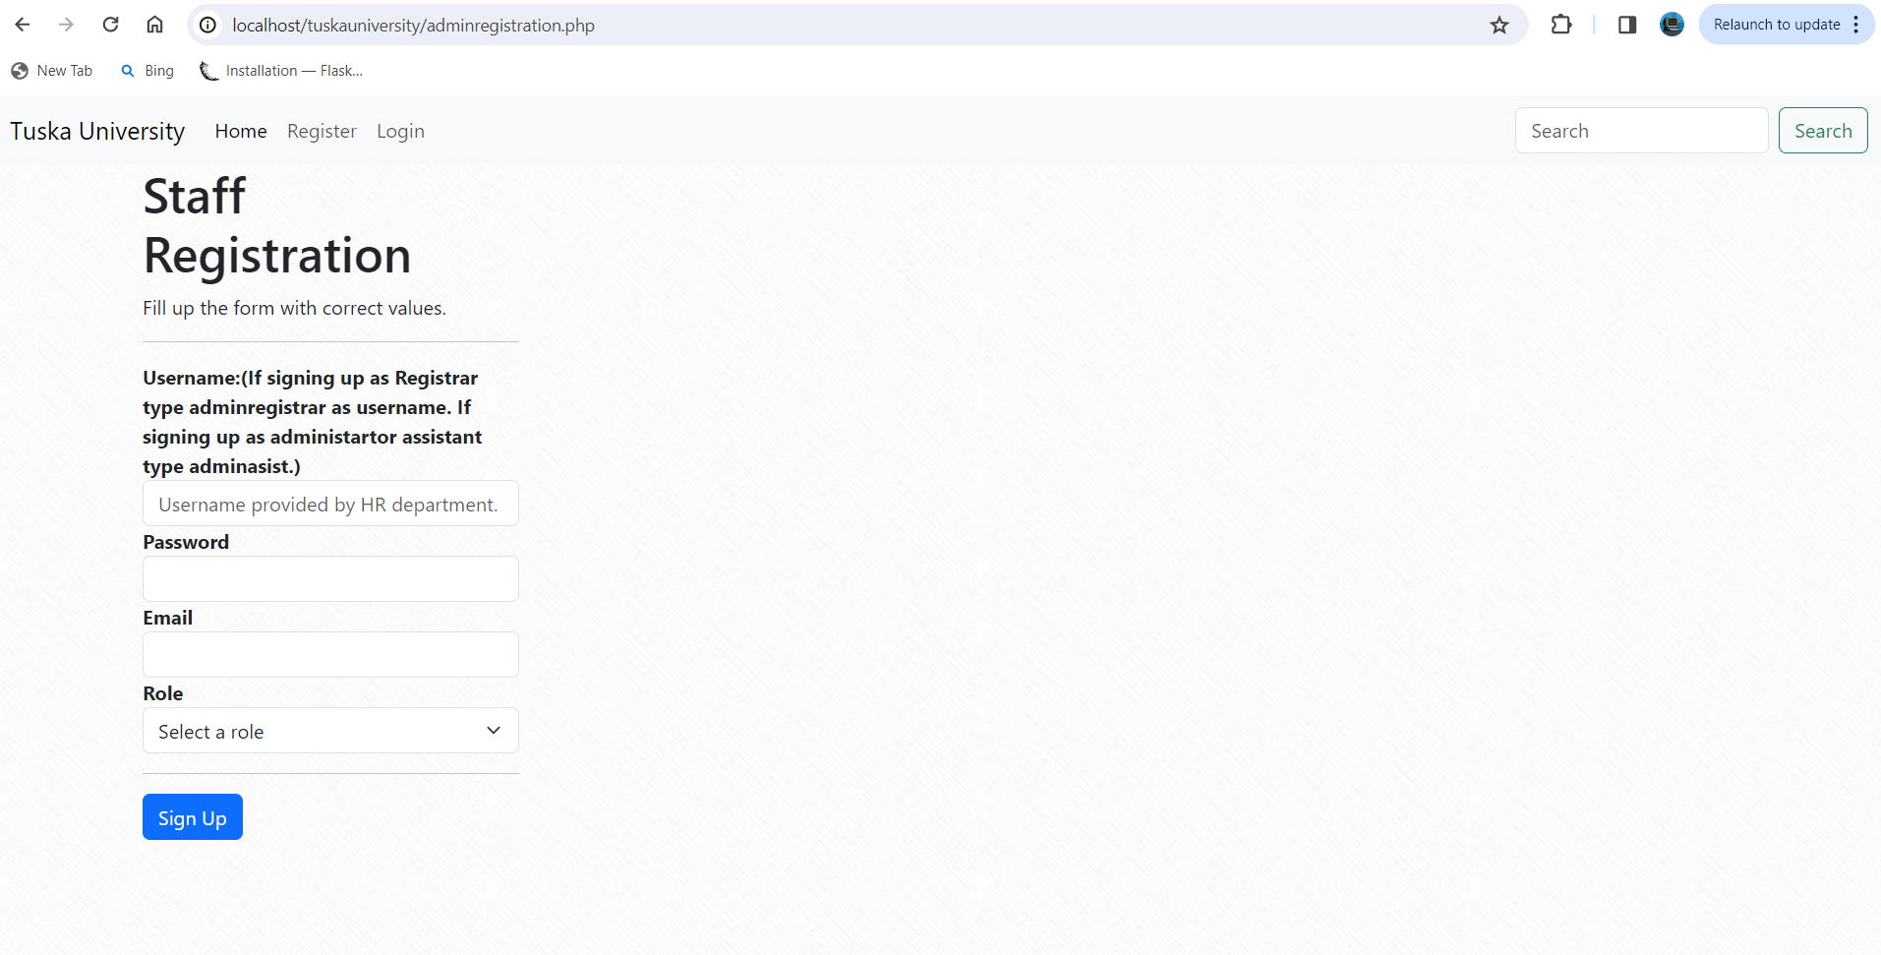
Registration pages
Notes:
After the user select what they are trying to register as, they are then redirected to the page of their decision. These are the both webpages of both options that a user is redirected to regarding their reason of registration.

Slide 28
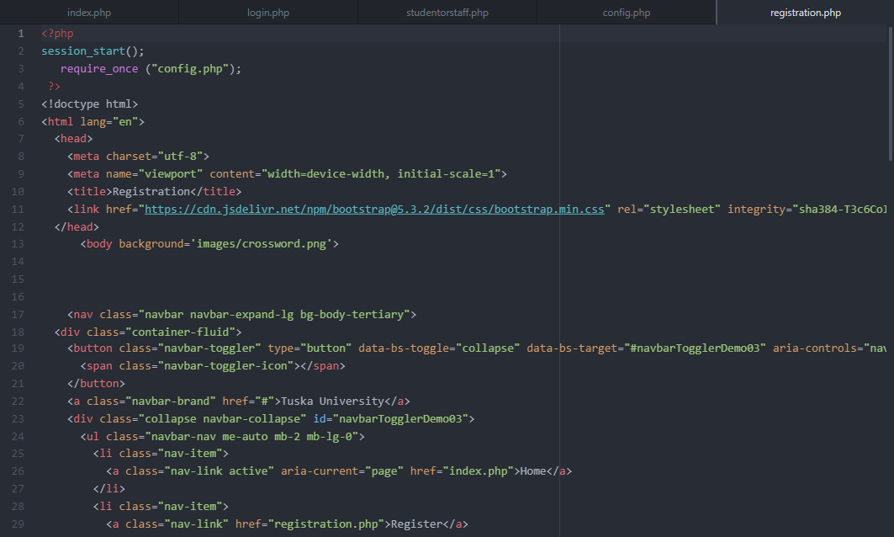
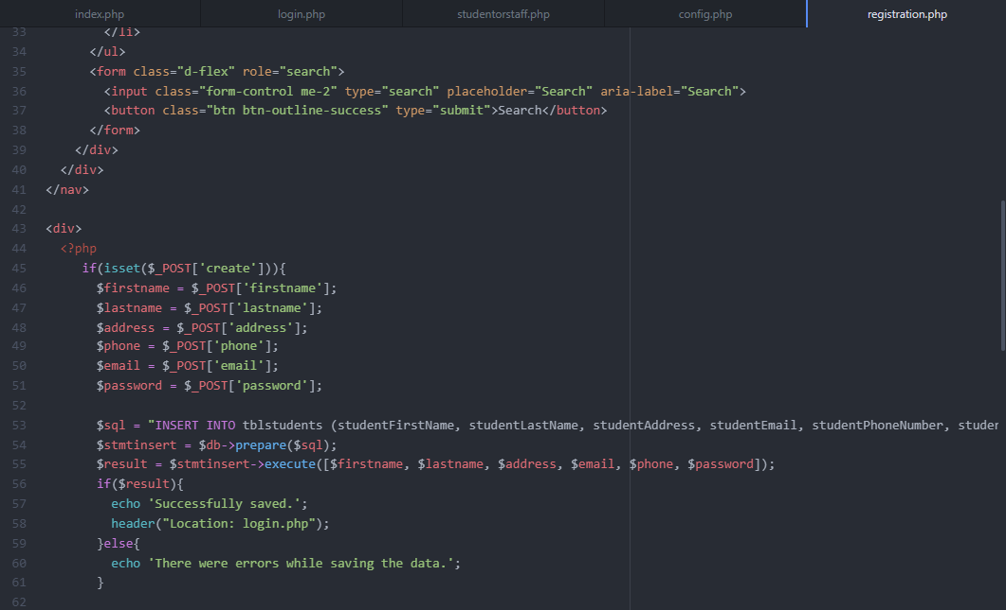
Registration page PHP code
Notes:
In order to create a functional registration form I used PHP to start the session data and included my config.php file. This allow me to store information in variables to use across multiple pages and to communicate with my database.

Slide 29
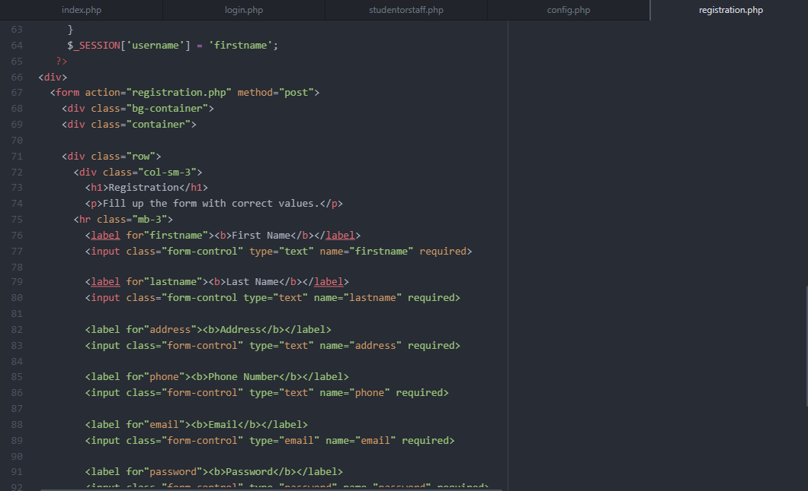
Registration php code cont.
Notes:
I also used PHP for form validation, handling form submission, and saving data to the database.

Slide 30
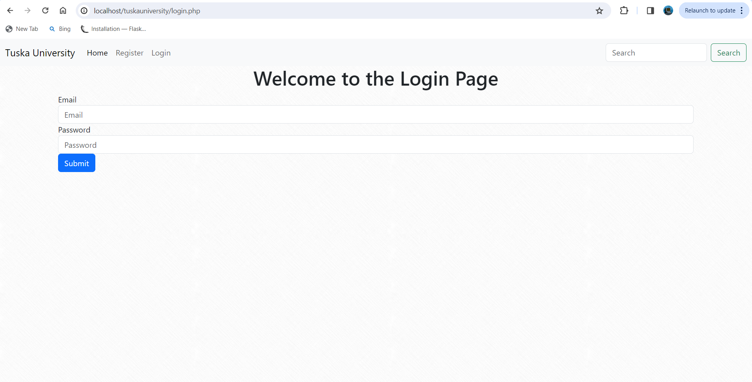
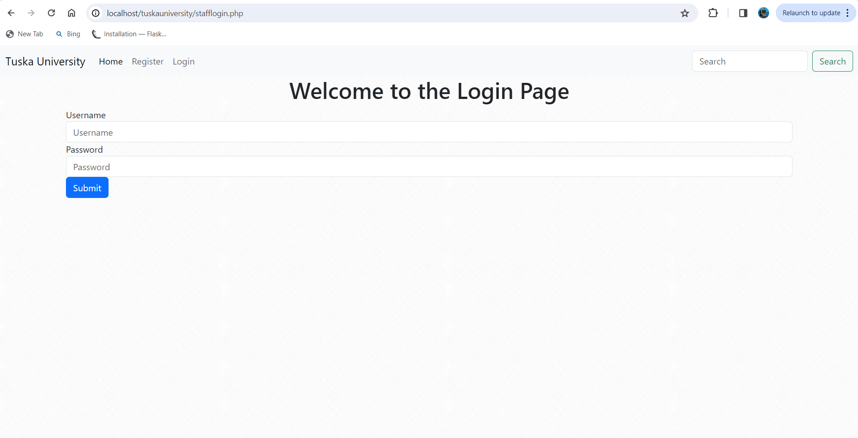
Tuska university login page
Notes:
After both student and administrator register they will be redirected to the login page. The login form is a simple form that ask each user for their username and password that they created.

Slide 31
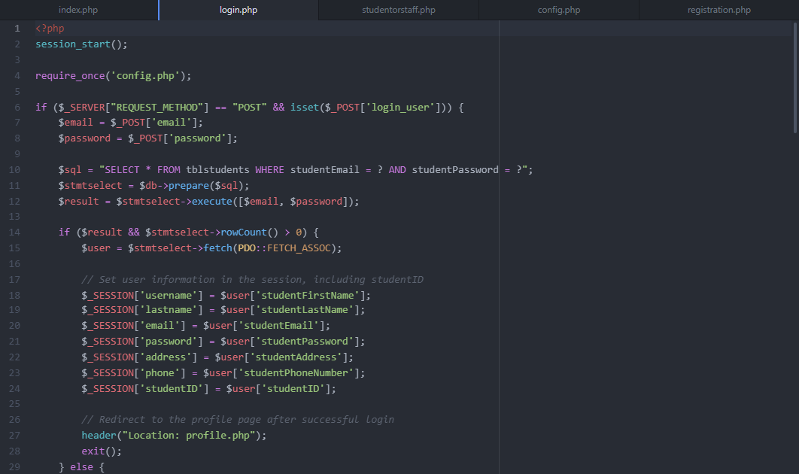
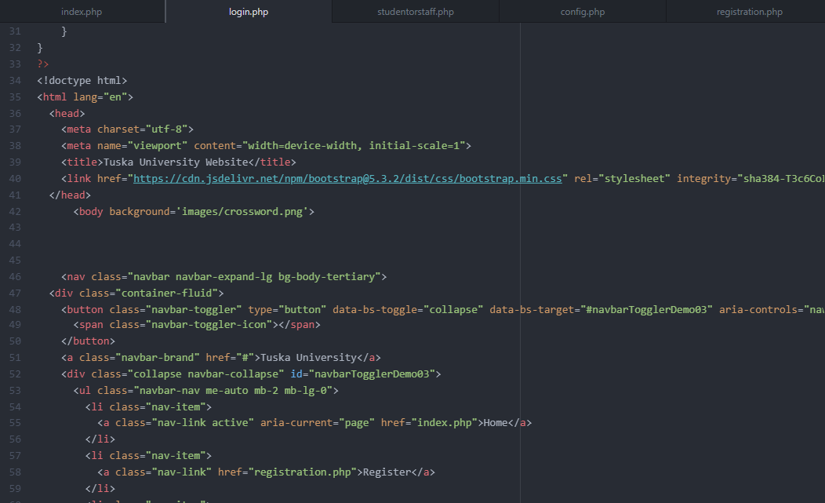
Tuska university login page php code
Notes:
This is the PHP code to the login form. This form handles user login and session management.

Slide 32
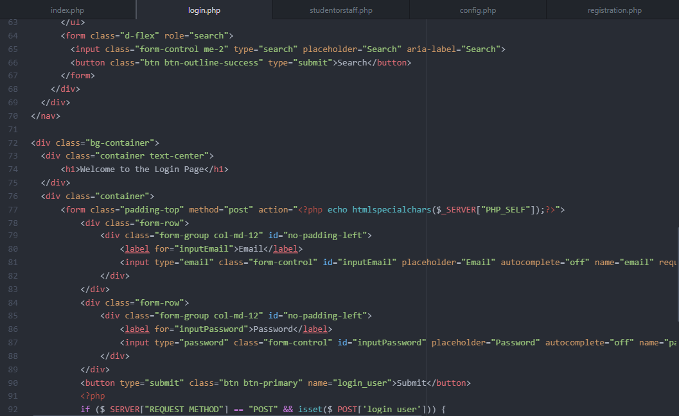
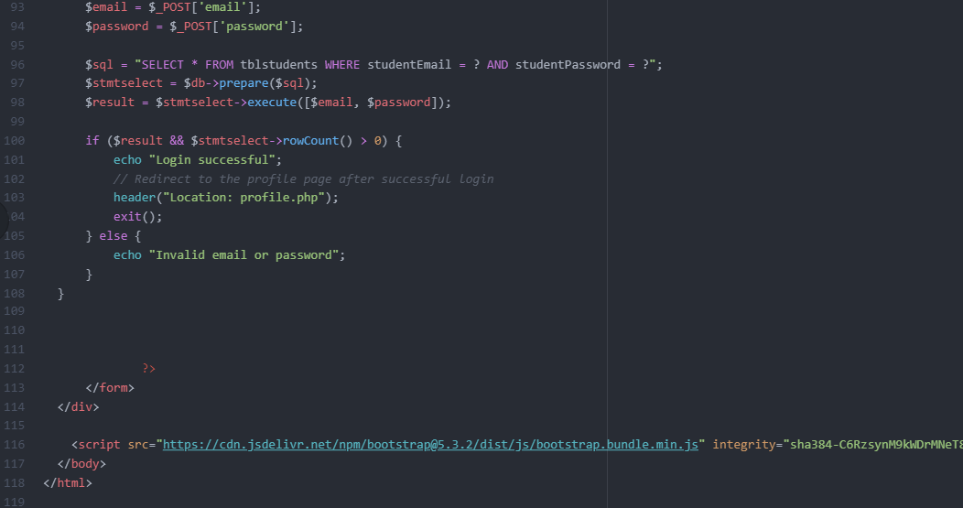
Tuska university login php code cont.
Notes:
After a successful login users will be redirected to their profile page.

Slide 33
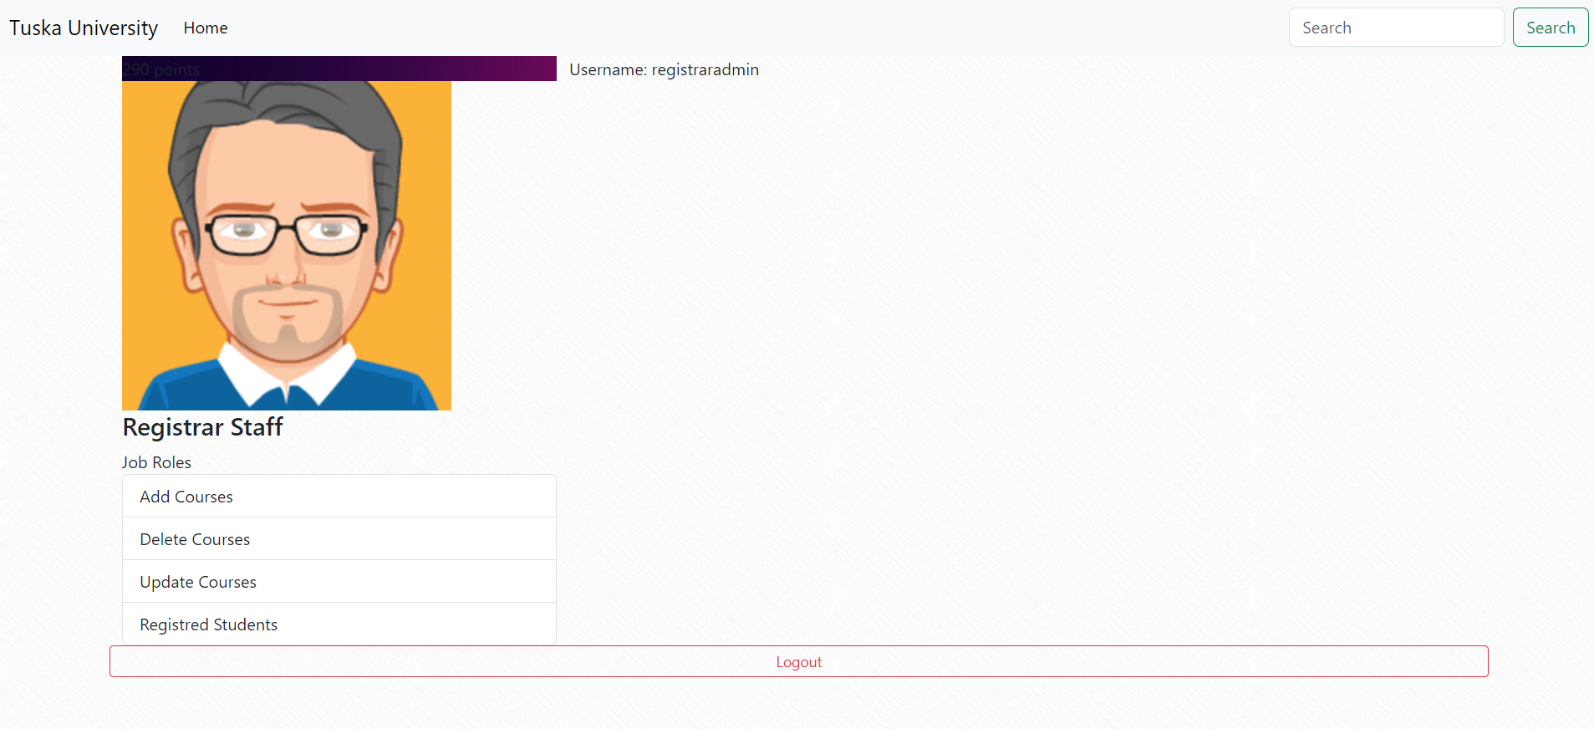
Admin Registrar profile
Notes:
The Admin registrar profile page is a simple card view. Upon entering the profile page the admin will be able to see their username, job title, and job responsibilities which is to add courses to the school's catalog, delete courses, and update courses.

Slide 34
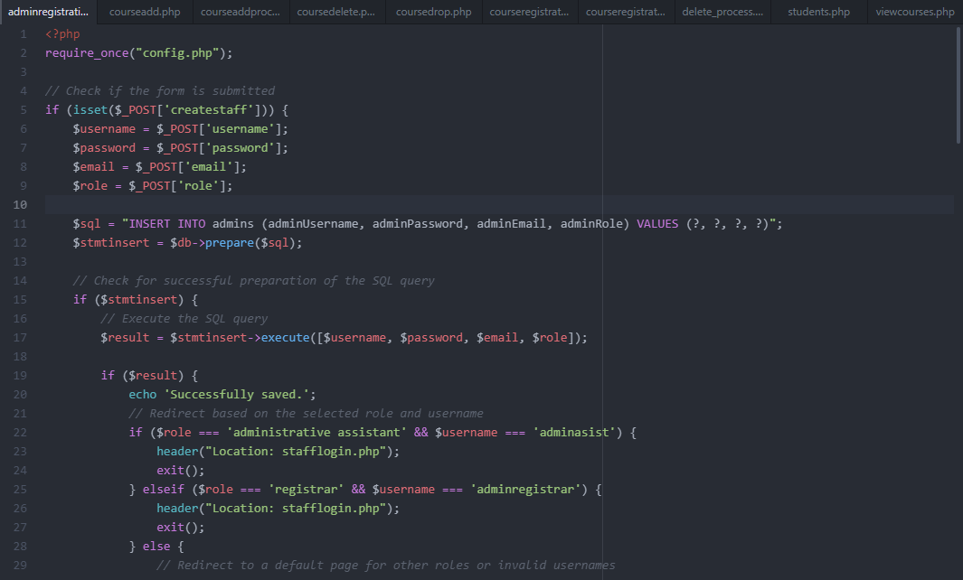
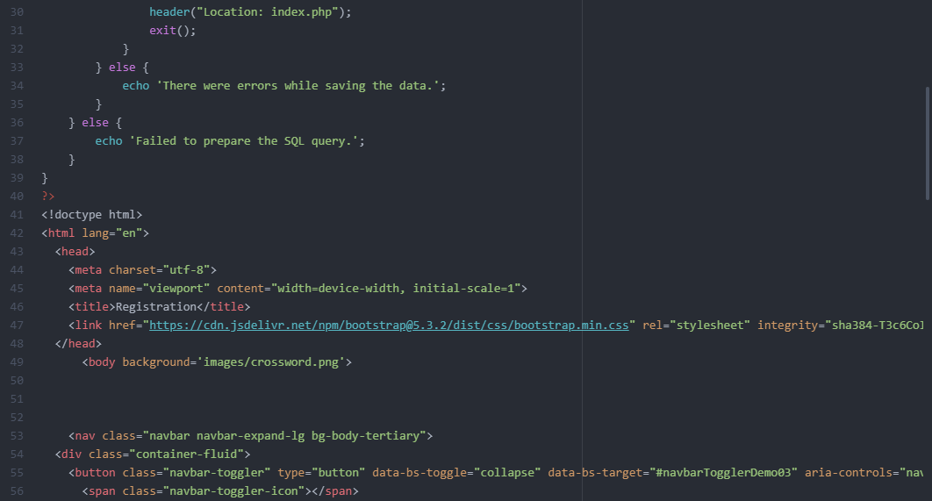
Admin registrar php profile code
Notes:
The logic behind the admin profile page is basically buttons that will redirect the user to different pages so they can carry out their primary functions.

Slide 35
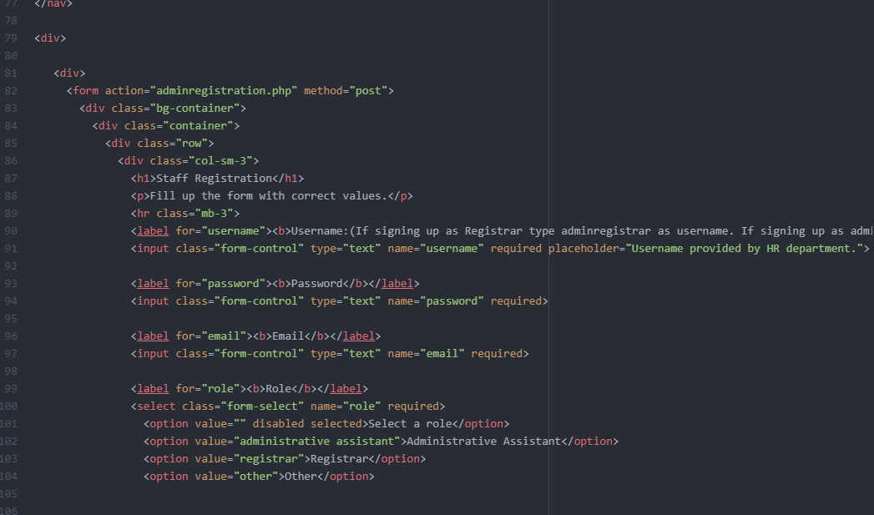
Admin registrar php code cont.

Slide 36
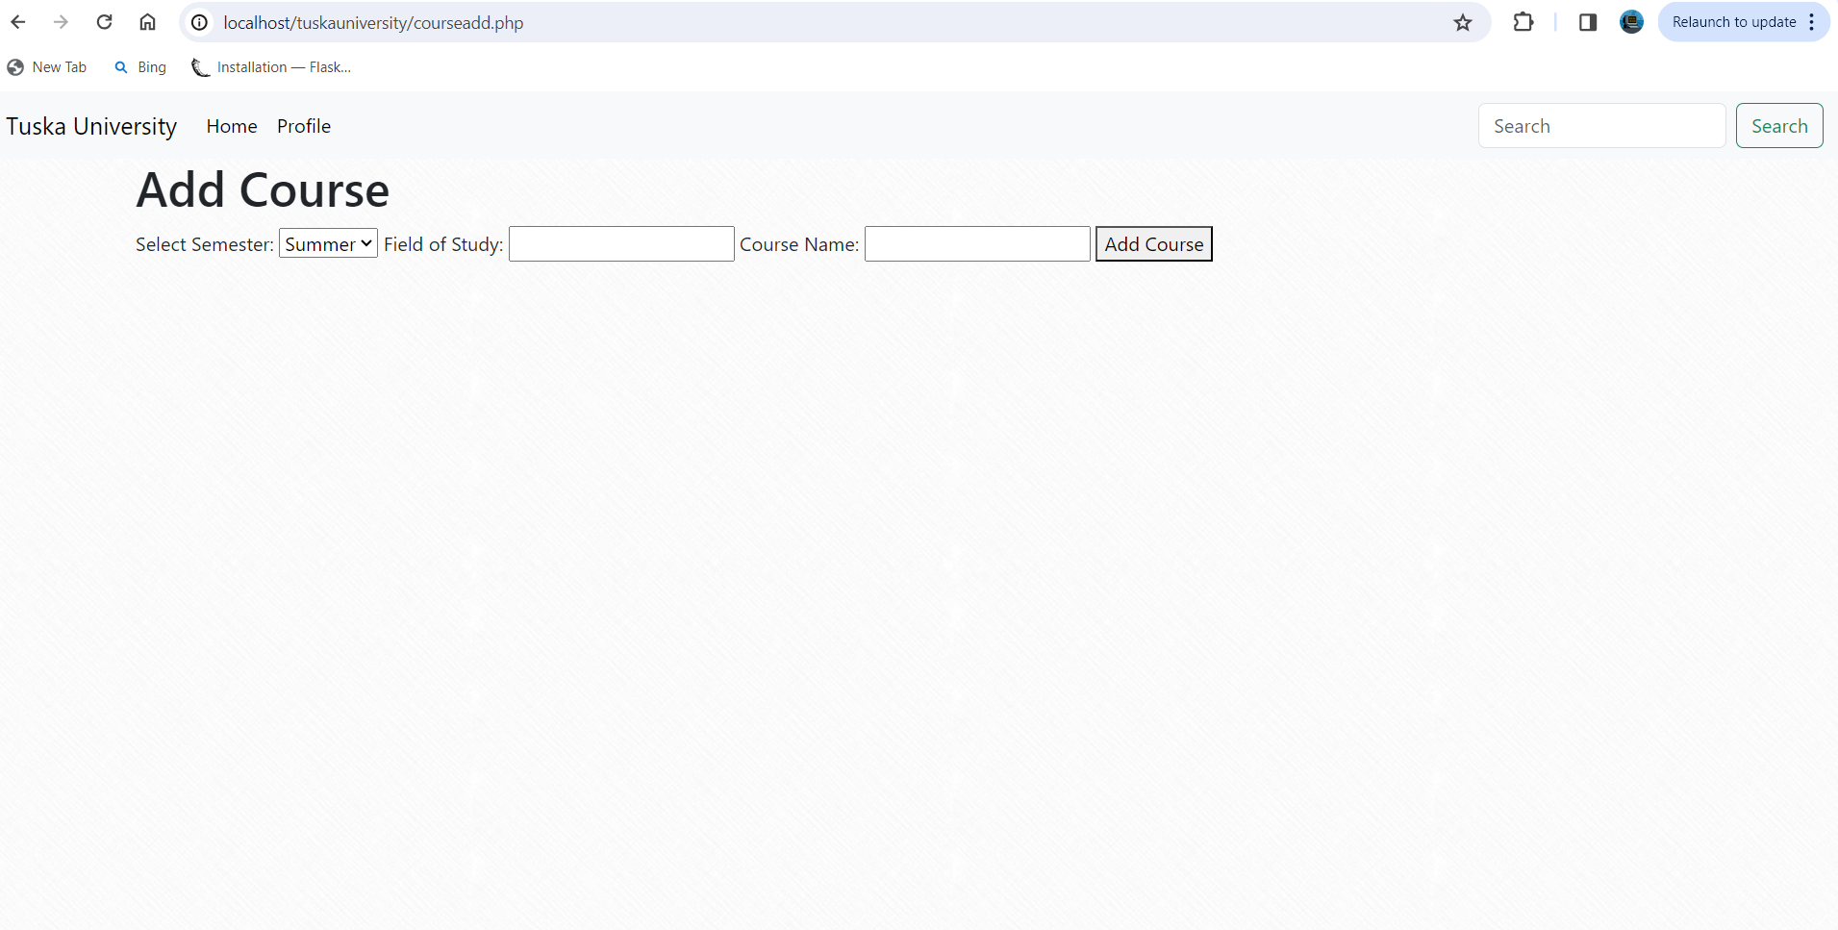
Admin course add form
Notes:
Once the admin click on the course add button they will be redirected to a form allowing them to select the semester they would like to add courses to. After selecting the semester they will need to type the field of study then the name of the course.

Slide 37
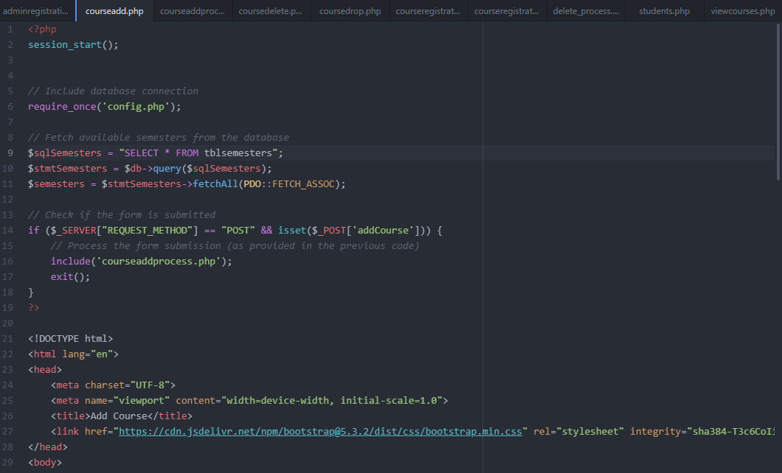
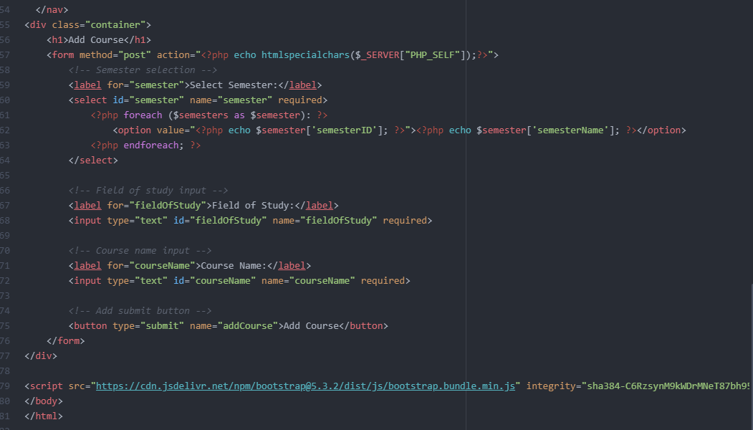
Admin Course add php code
Notes:
After pressing the submit button the user is once again redirected to another php file that is only responsible for handling the data of the added course.

Slide 38
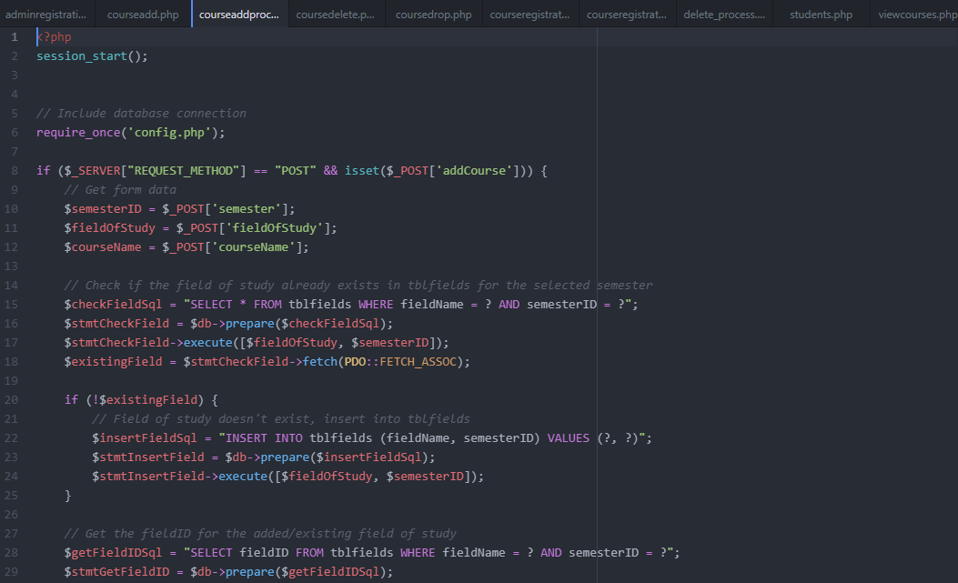
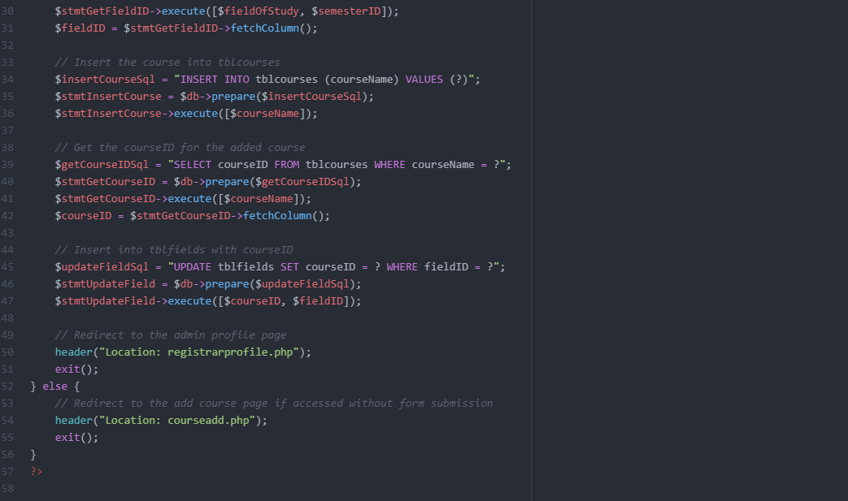
Admin course add process php code
Notes:
The processing page basically communicates with the database and handle the input data accordingly to the functional requirements of the software system. This separation of concerns promotes both low coupling and high cohesion.

Slide 39
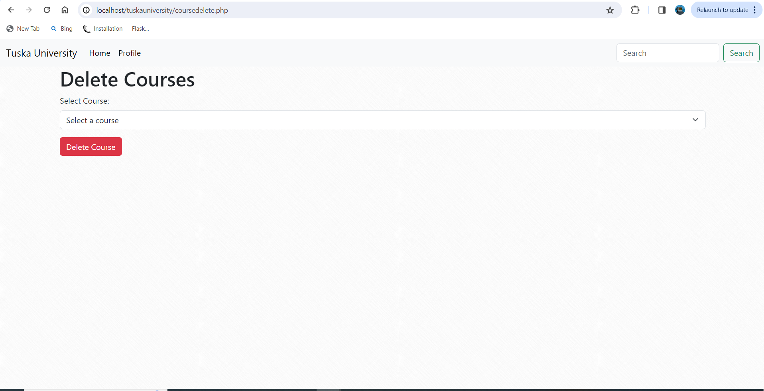
Admin course delete form
Notes:
The admin will also be able to delete courses against the schedule.

Slide 40
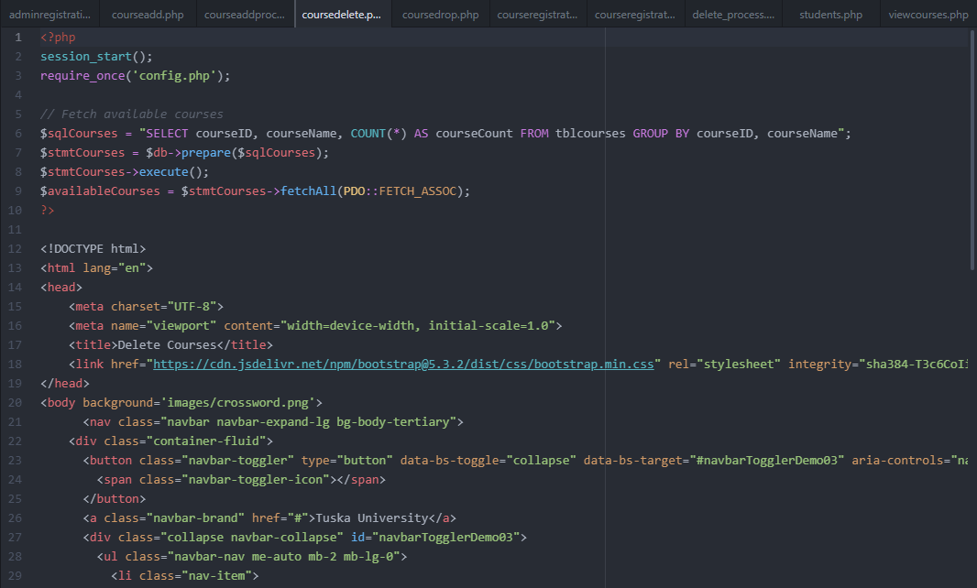
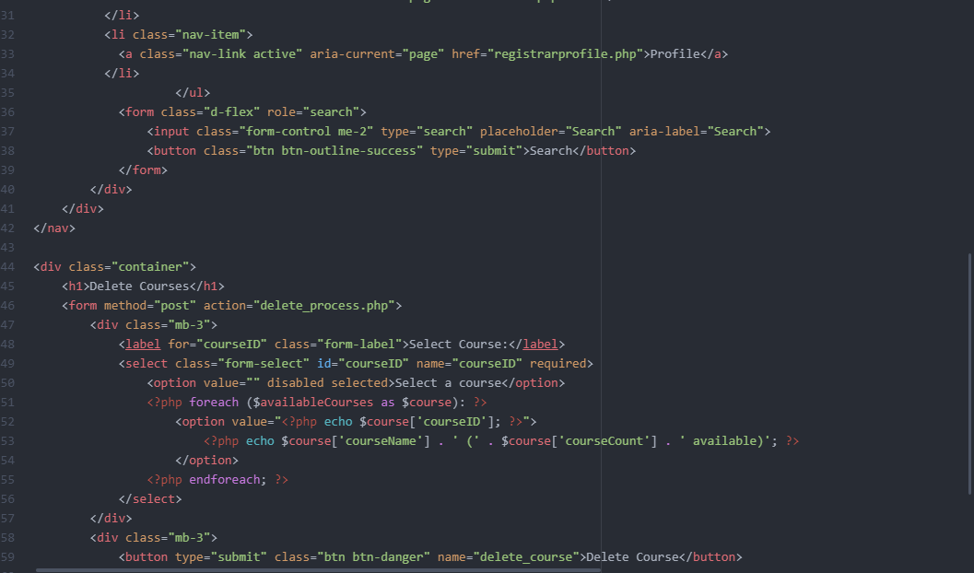
Admin course delete php code
Notes:
There will be a dropdown menu of all of the classes on the schedule based on semester and field of study. Once the admin select the course they would like to delete. The change will be reflected across the entire system.

Slide 41
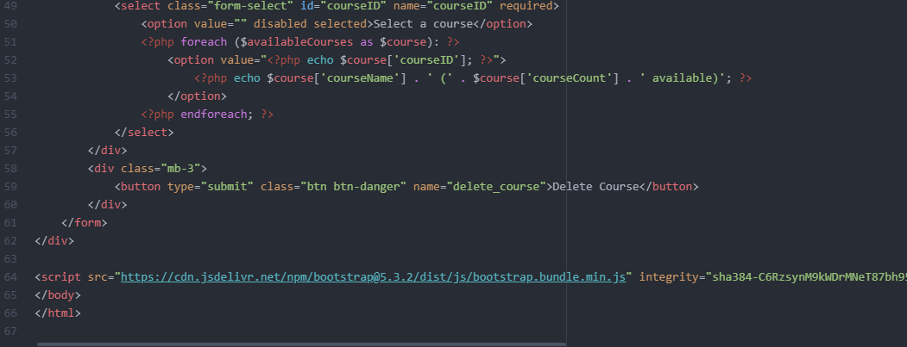
Admin course delete php code cont.

Slide 42
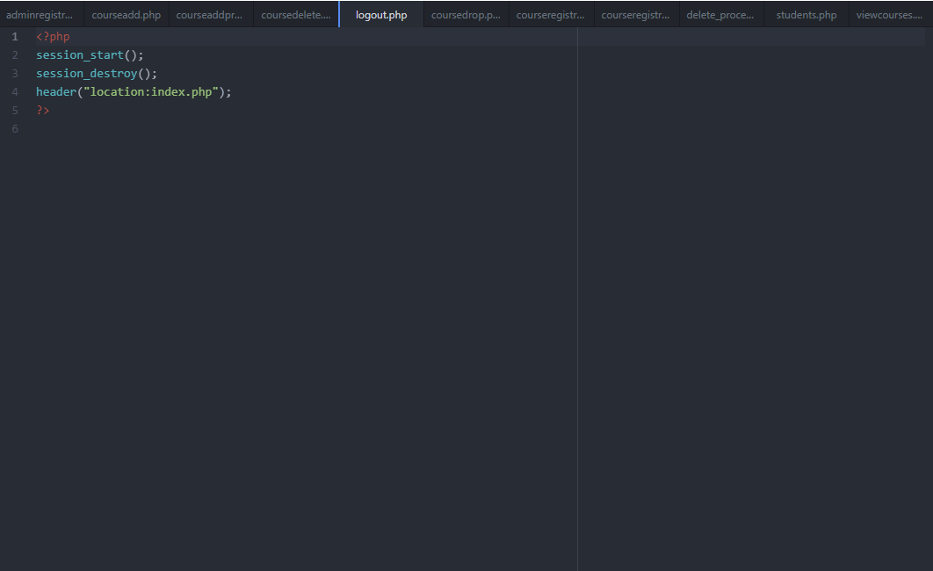
Admin logout php code
Notes:
Once a user selects the logout option their session will then end and they will be redirected to the landing page which is titled index.php. In order for them to access their page again they will need to login.

Slide 43
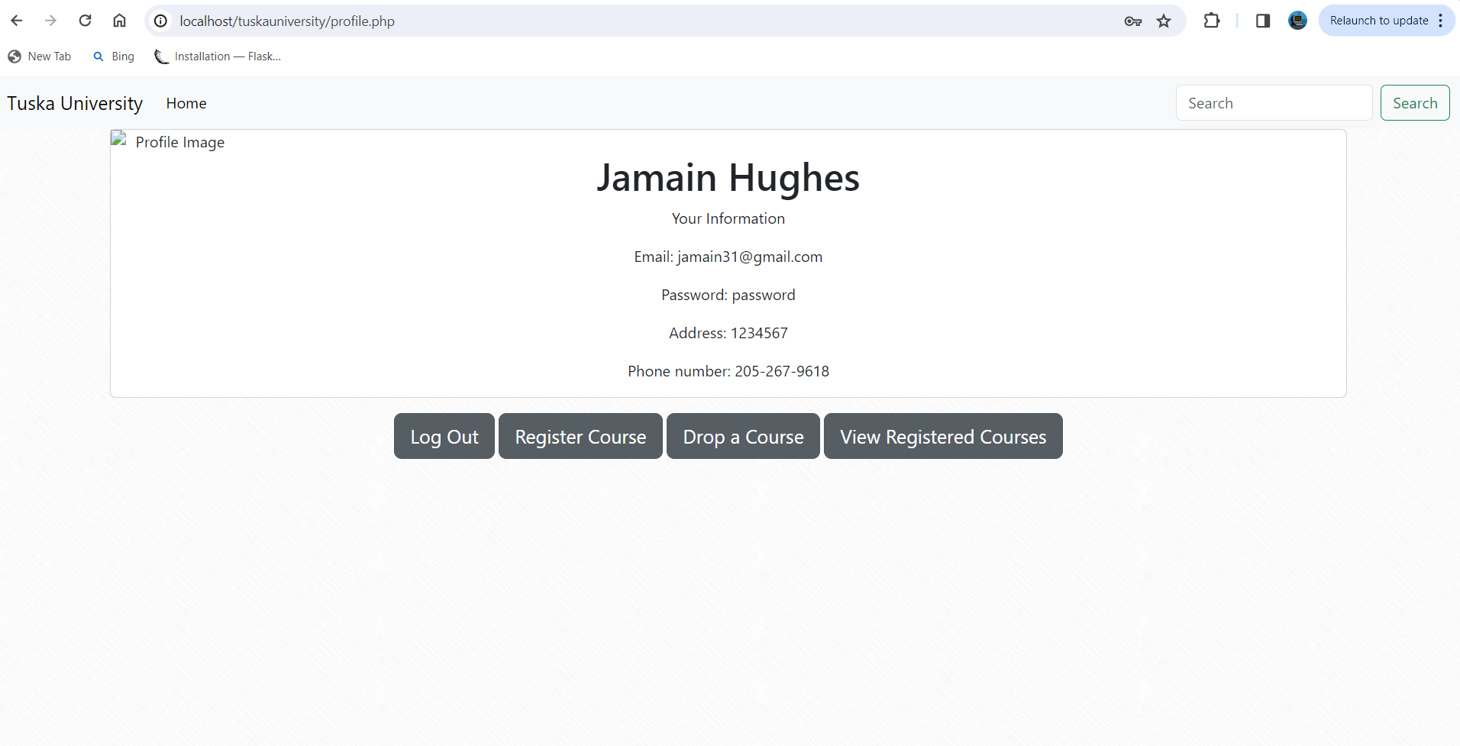
student profile page
Notes:
The student profile page is also a simple card design that will display the student's information such as their name, email address, password, physical address, and phone number.

Slide 44
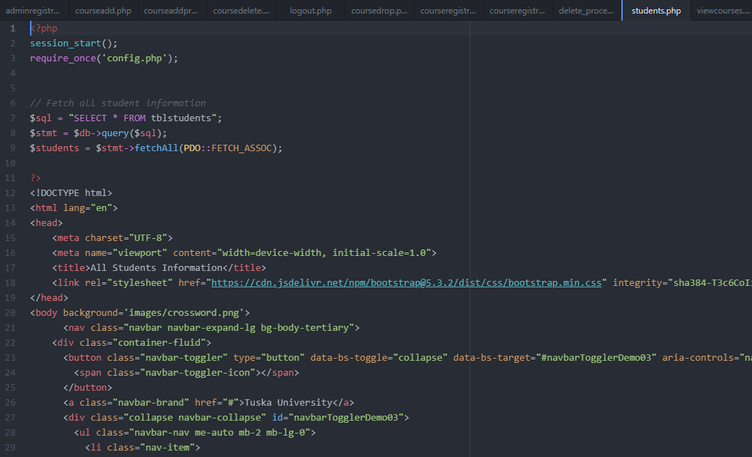
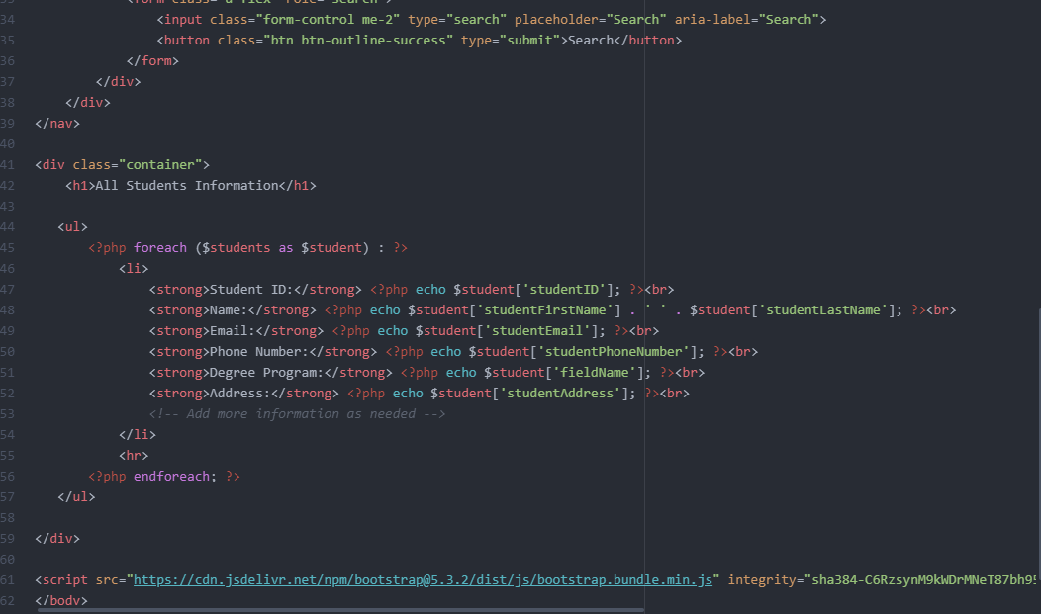
Student profile page php code
Notes:
Beneath their information are four clickable buttons. These buttons allow for students to logout, register for courses, drop courses, and view their schedule.

Slide 45
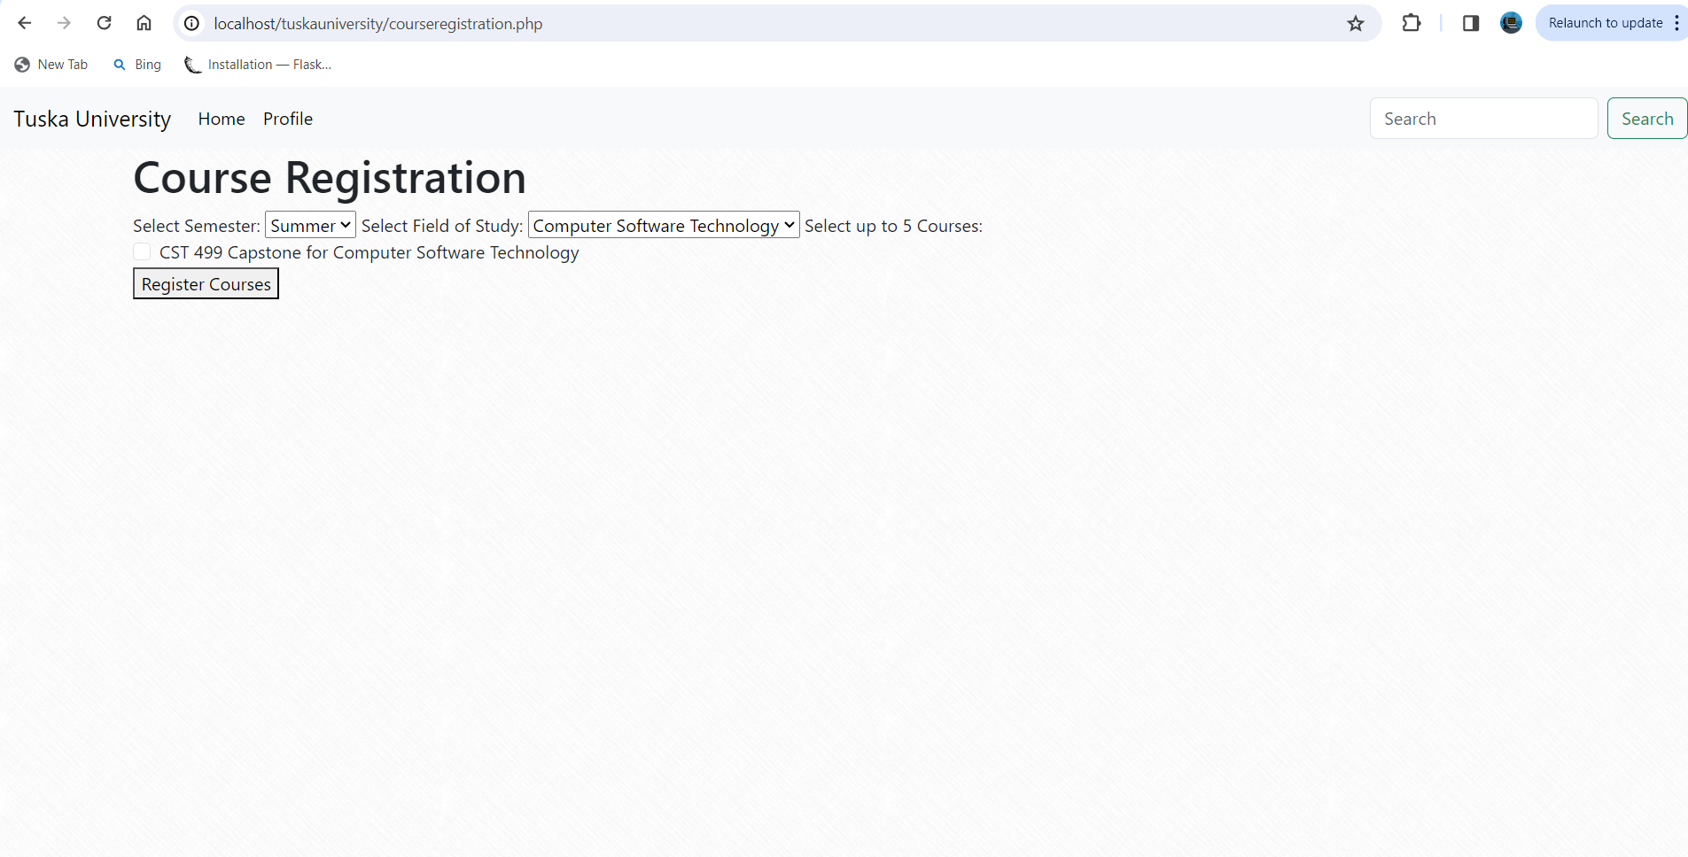
Student course registration page
Notes:
Upon clicking register for course, students will be redirected to a file that has a course registration form. The registration form allow students to select their desired semester, field of study, and courses within the field.

Slide 46
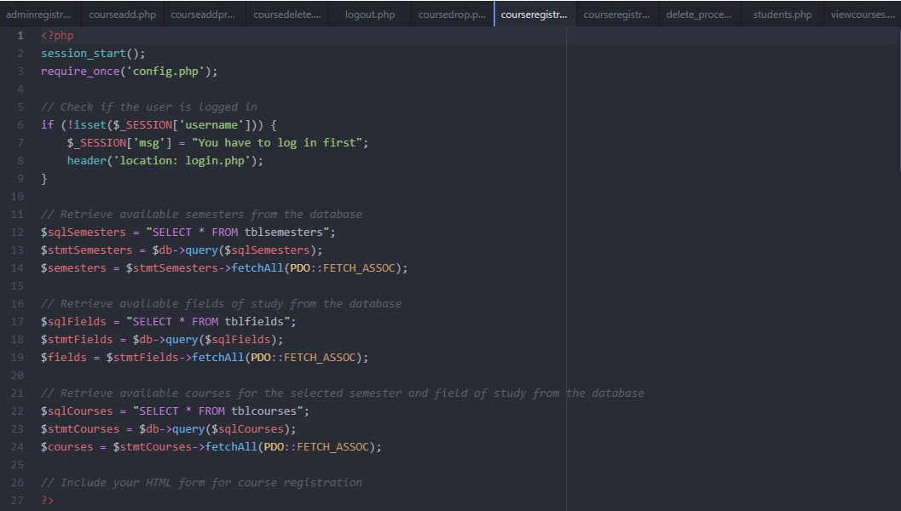
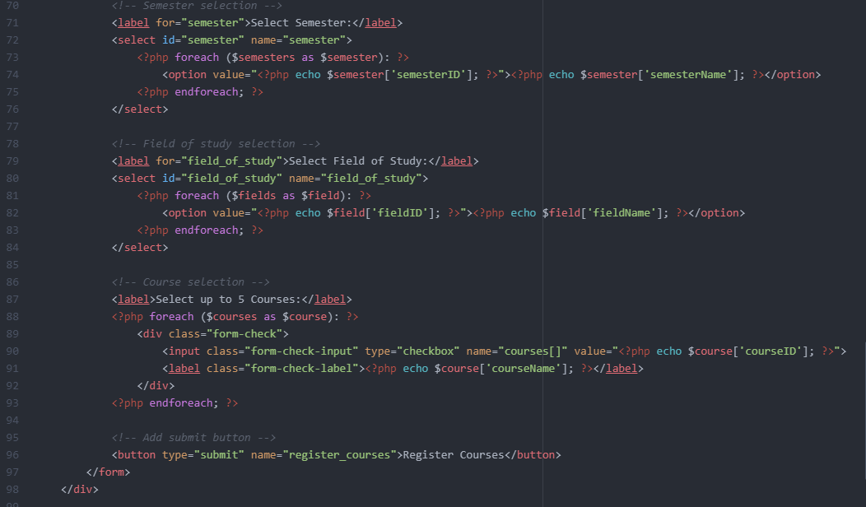
Student course registration php code
Notes:
Students will be able to select up to five courses at a time. After submitting their selection, the course will be taken out of the query. If there aren't anymore of a particular type of course available, students won't be able to select that course until another student has dropped it.

Slide 47
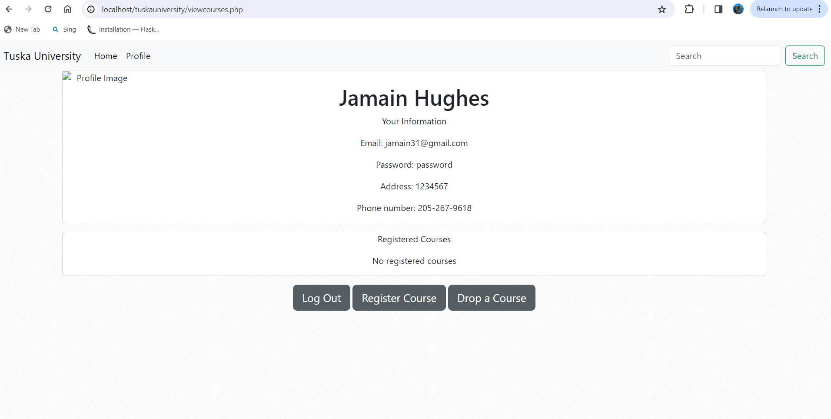
Student course view page
Notes:
In order for a student to view the courses they have applied to, they will need to click the button labeled view courses.

Slide 48
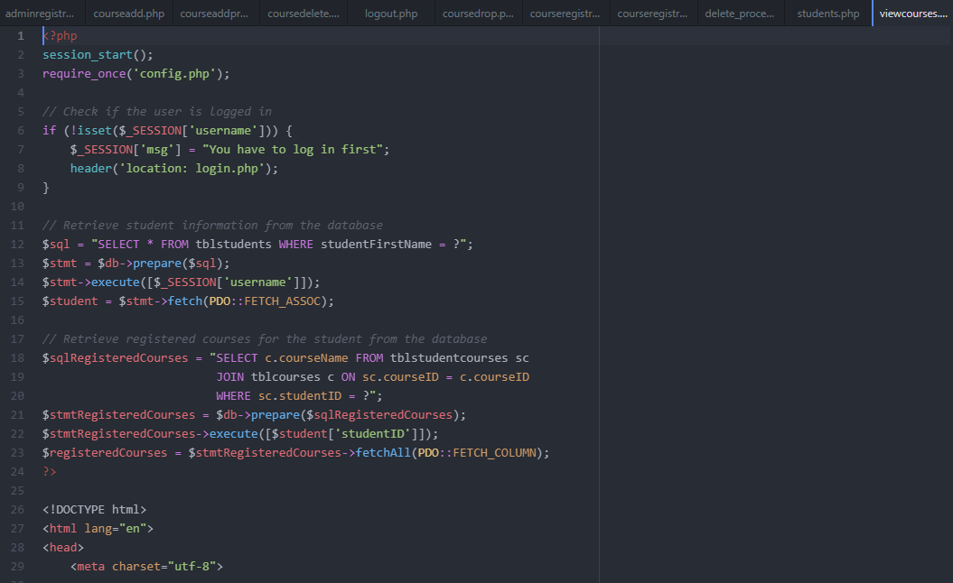
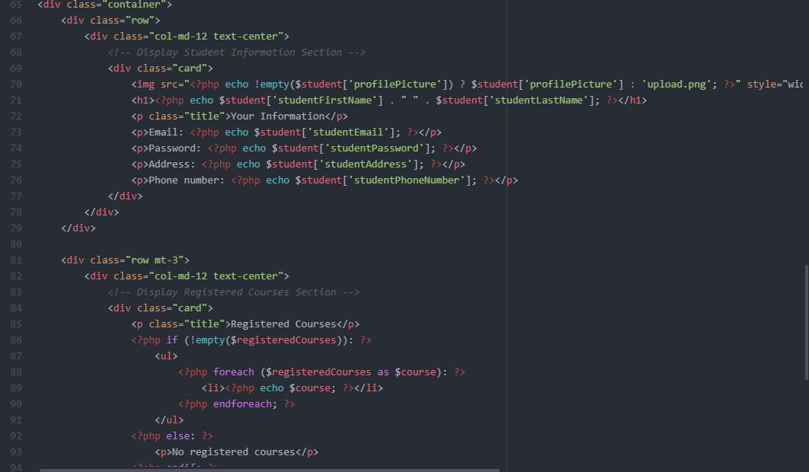
Student course view page php code
Notes:
Upon clicking the view course button, there will be a drop down of the courses that each student have registered for.

Slide 49

Student course drop page
Notes:
In order for a student to drop a course they need to click the drop course button.

Slide 50


Student course drop php code
Notes:
Upon clicking the drop course button, students will be redirected to another file that is responsible for processing the data.

Slide 51


Student course drop php code cont.
Notes:
This file will communicate with the database in order to remove the course from the student's schedule and back into the course catalog making it available for other students to apply for that course.

Slide 52

Student logout php code
Notes:
Once the user is done using the website they can click on the log out button which will destroy their session and redirect them back to the landing page.

Slide 53
References
DeBarros, A. (2022). Practical SQL: A beginner’s guide to storytelling with data.
No Starch Press.
Duckett, John. (2014). HTML & CSS: Design and build websites. John Wiley and Sons.
Duckett, Jon, Ullman, C., & Stone, E. (2022). PHP & MySQL: Server-side web development.
John Wiley & Sons.
Guide to the software engineering - fit.edu. (n.d.).
https://cs.fit.edu/~kgallagher/Schtick/Serious/SWEBOKv3.pdf
Mikoluk, K. (2013, September 18). XAMPP tutorial: How to use XAMPP to run your own web
serverLinks to an external site. Udemy.https://blog.udemy.com/xampp-tutorial.
SiteGround. (n.d.). phpMyAdmin create and populate tables tutorial. Links to an external site.
https://www.siteground.com/tutorials/phpmyadmin/create-populate-tables/
Tsui, F., Karam, O., & Bernal, B. (2018). Essentials of software engineering (4th ed.). Jones &
Barlett Learning.

Slide 54

Thank You
Jamain Hughes
The University of Arizona Global Campus
CST 499: Capstone for Computer Software Technology
Professor: Dr. Amjad Alkilani
January 29, 2024

